Slide 1
‘Glass Half Full or Empty’:
Illuminating the Human Transcriptome
Lecture 1

Slide 2
What is the world?

Slide 3

What is the world?

Slide 4
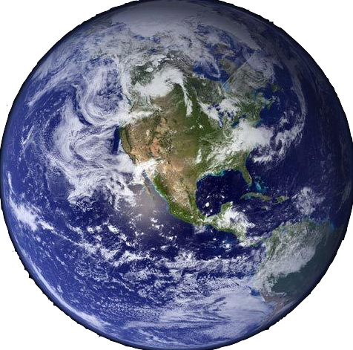
What is the world?

Slide 5

What is the world?

Slide 6
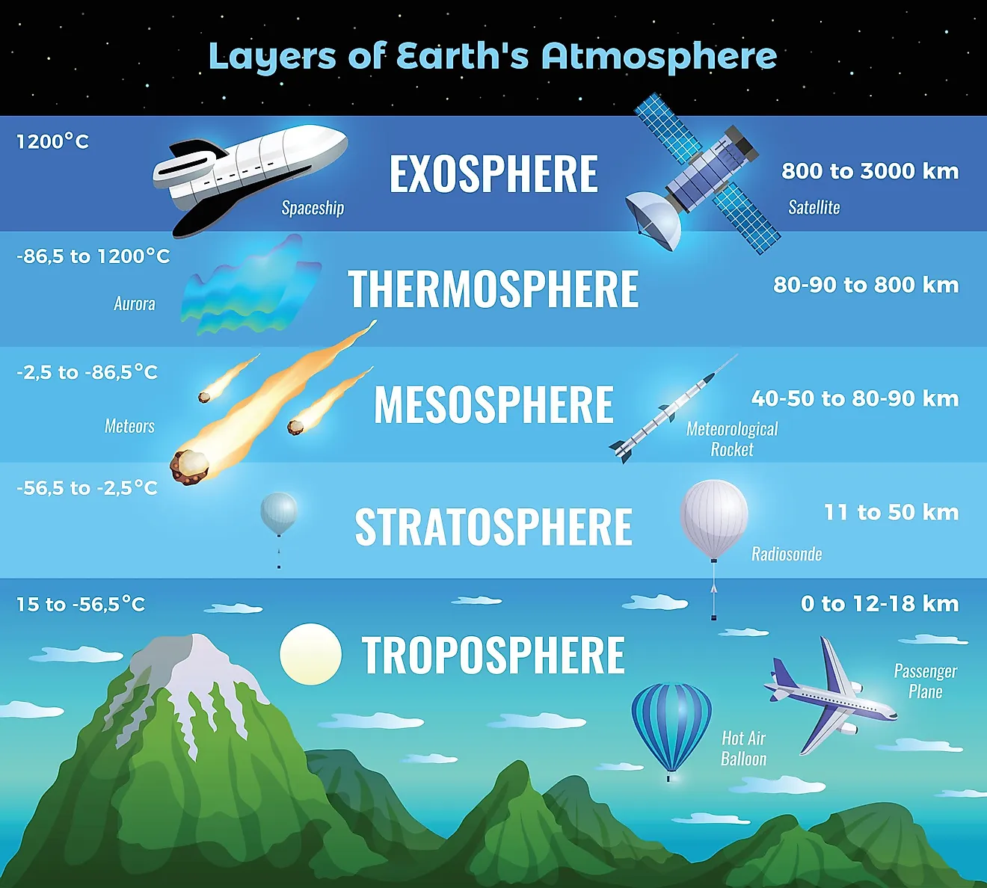
What is the world?
This course focuses on two specific layers within biology

Slide 7
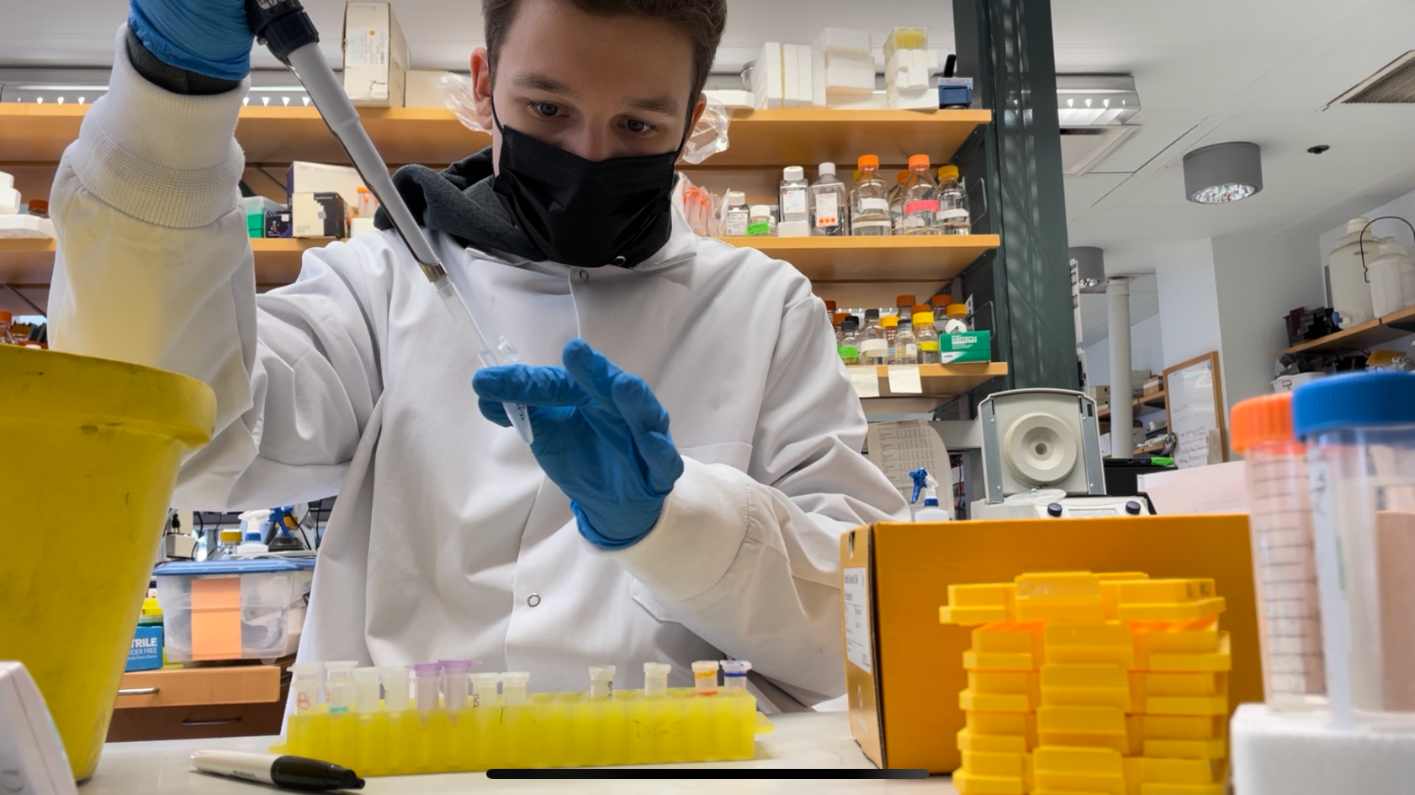
Why Biology?
Biology = Life
Biology + Medicine = More Life
Notes:
Instructor Intro

Slide 8
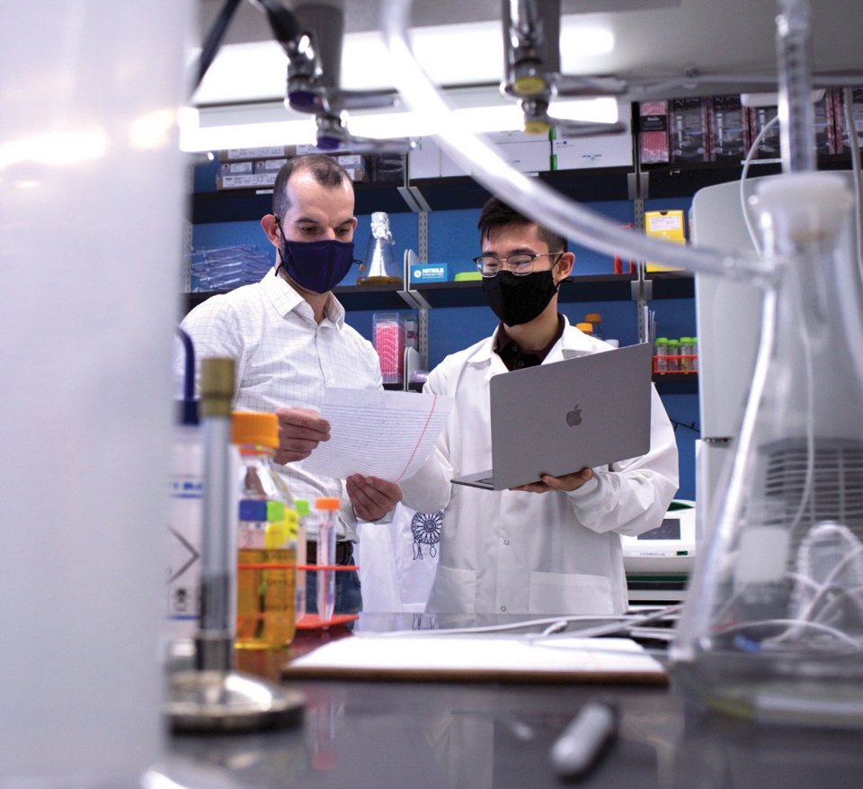
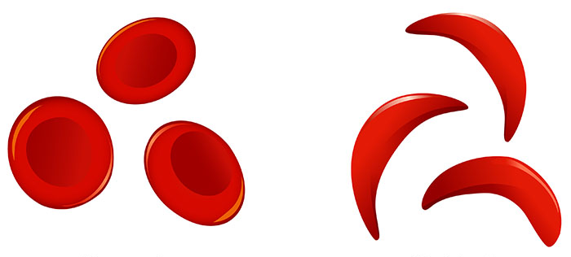
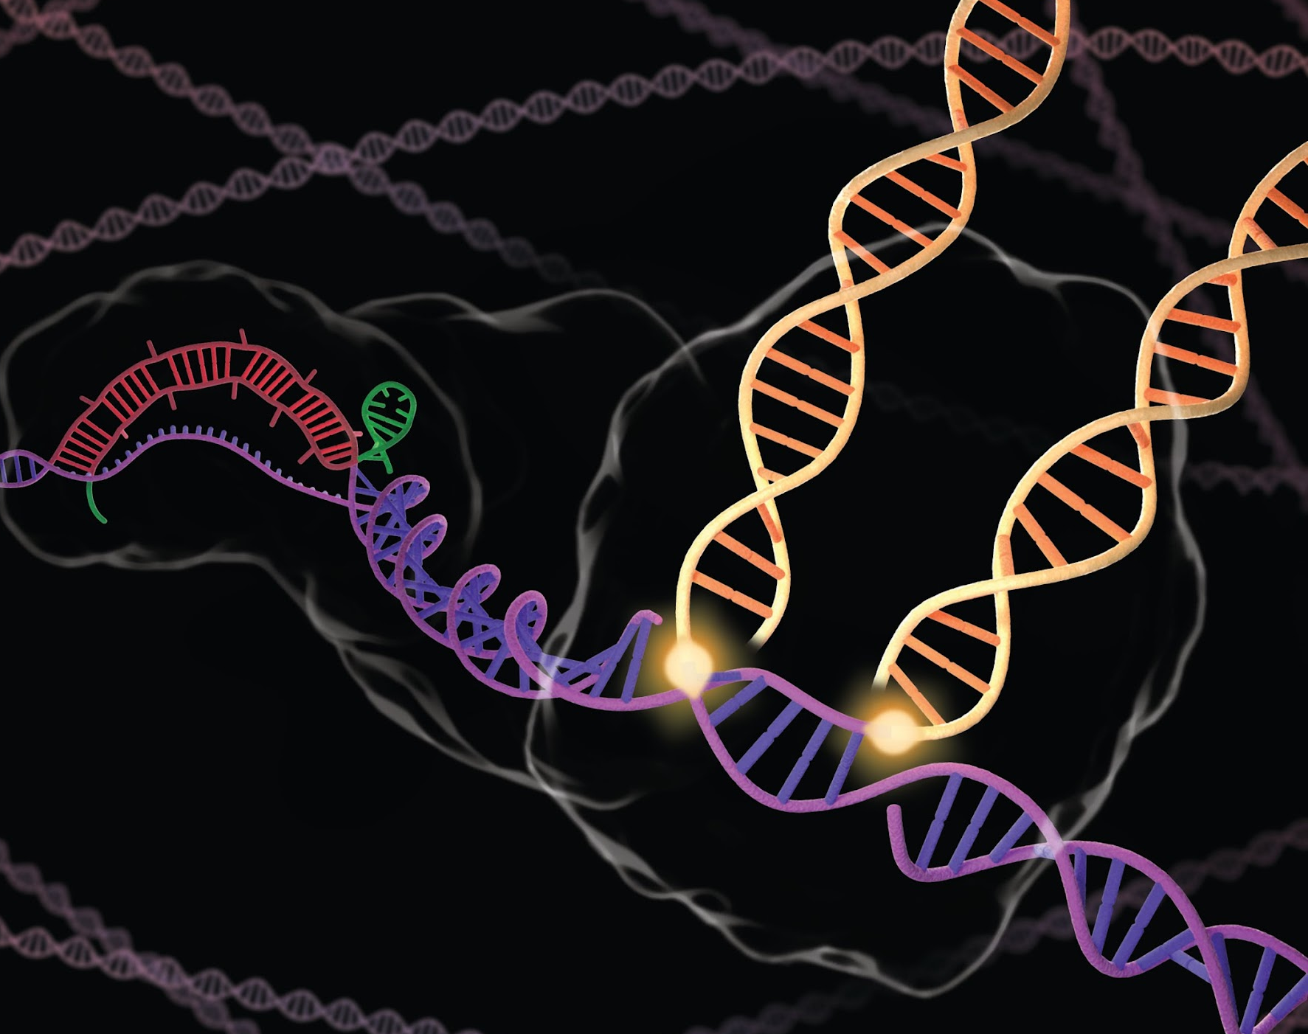
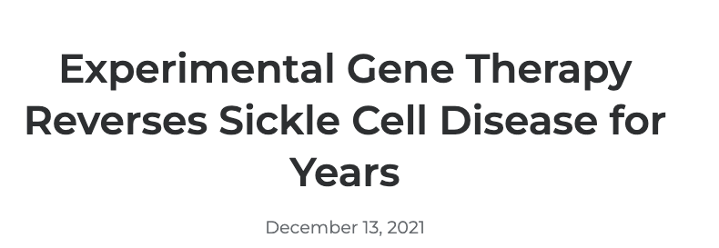
Why Biology?
Biology = Life
Biology + Medicine = More Life
Rewriting the code of life with CRISPR
Notes:
Instructor Intro

Slide 9
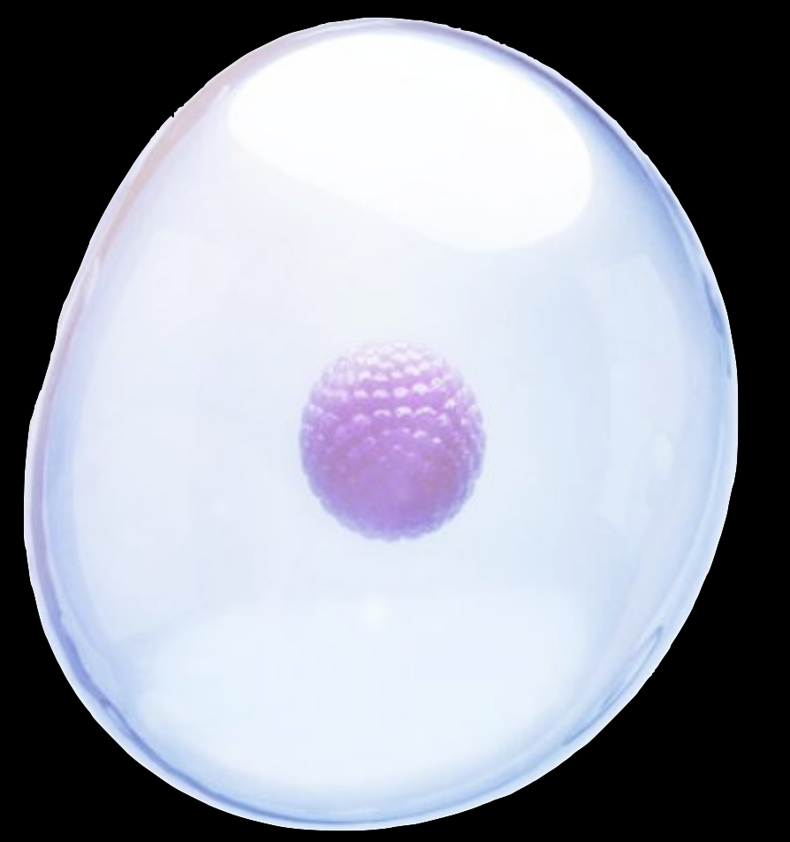
The World of Biology
The Cell
Notes:
image: https://www.genome.gov/genetics-glossary/Deoxyribonucleic-Acid

Slide 10
The World of Biology
Nucleus => DNA
RNA
Protein
Cytoplasm
The Cell

Slide 11
The World of Biology
The Cell
Notes:
image: https://www.genome.gov/genetics-glossary/Deoxyribonucleic-Acid

Slide 12
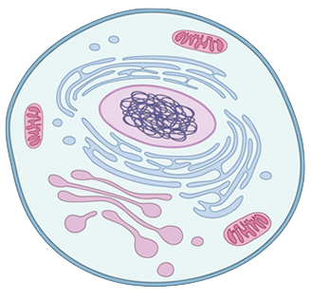
The World of Biology
Nucleus
Cytoplasm
The Cell
Notes:
image: https://www.genome.gov/genetics-glossary/Deoxyribonucleic-Acid

Slide 13
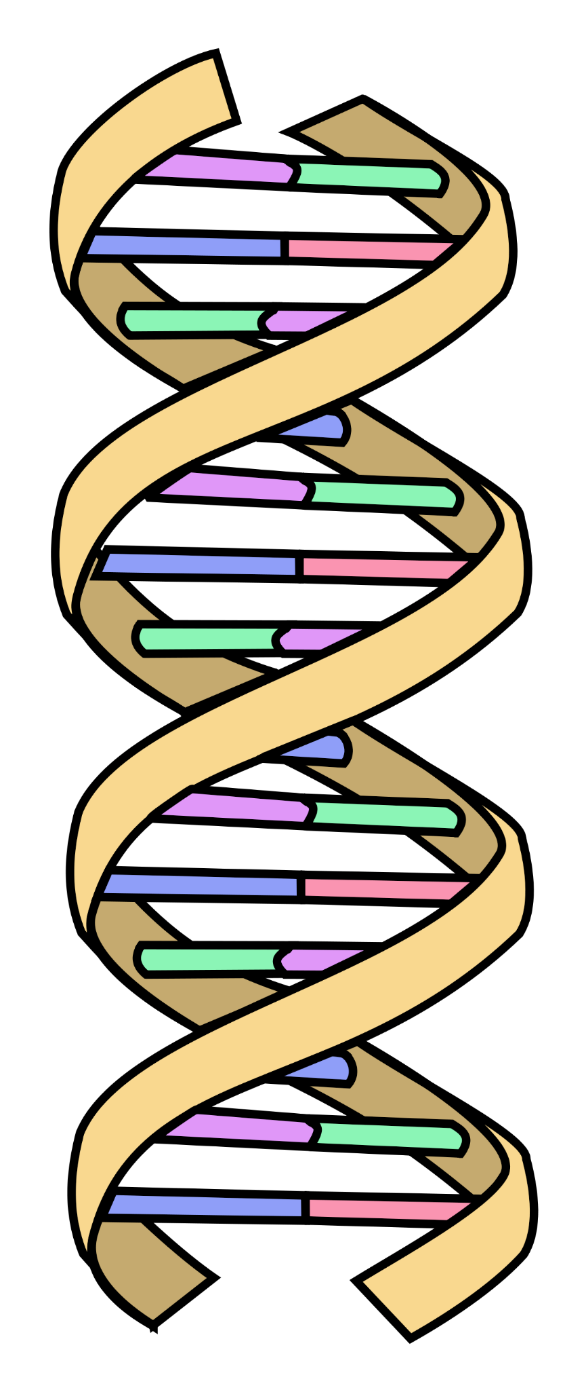
DNA in the Nucleus
Nucleus => DNA
The Cell
Notes:
https://en.wikipedia.org/wiki/File:DNA_simple.svg

Slide 14
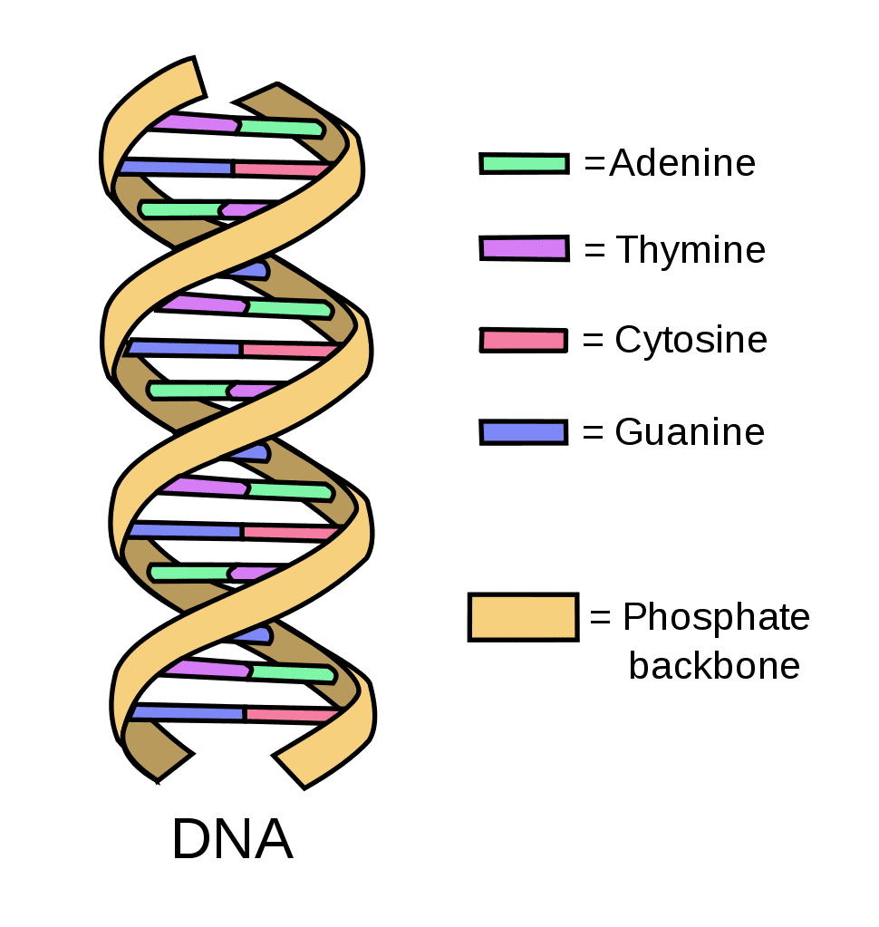
DNA in the Nucleus
Notes:
https://en.wikipedia.org/wiki/File:DNA_simple.svg

Slide 15
DNA in the Nucleus
ACTCTGAGACTCTG
Notes:
https://en.wikipedia.org/wiki/File:DNA_simple.svg

Slide 16
Your Turn
TGAGACTCTGAGAC
Notes:
https://en.wikipedia.org/wiki/File:DNA_simple.svg

Slide 17
Think about it a different way
ACTCTGAGACTCTG
TGAGACTCTGAGAC
Notes:
https://en.wikipedia.org/wiki/File:DNA_simple.svg

Slide 18
Worksheet Time!
Notes:
https://en.wikipedia.org/wiki/File:DNA_simple.svg

Slide 19
The Genome
Nucleus => DNA
The Cell
Notes:
https://en.wikipedia.org/wiki/File:DNA_simple.svg

Slide 20
The Genome
Nucleus => DNA
The Cell
Notes:
https://en.wikipedia.org/wiki/File:DNA_simple.svg

Slide 21
The Genome
Nucleus => DNA
AGCCTTCTGGGTCCGAGGCTCCCACCTGCTCTAAGCGCTTGACACCCTTTAAAAAAATGTATTTAAAGAG
GCTGGTTCCTATCCATCCGACTGGAGGCATCTCAGTGCAAGAGCAAAGCTAAGTCCTGCACACGCTCCTC...
Notes:
https://en.wikipedia.org/wiki/File:DNA_simple.svg

Slide 22
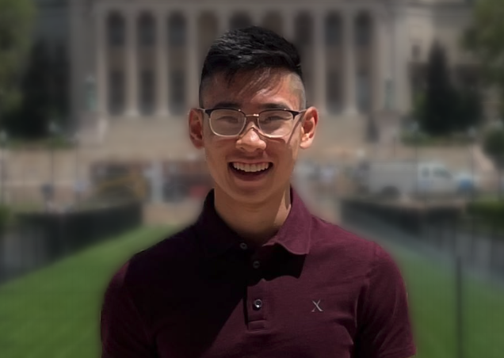
The Human Genome
Nucleus => DNA
AGCCTTCTGGGTCCGAGGCTCCCACCTGCTCTAAGCGCTTGACACCCTTTAAAAAAATGTATTTAAAGAG
GCTGGTTCCTATCCATCCGACTGGAGGCATCTCAGTGCAAGAGCAAAGCTAAGTCCTGCACACGCTCCTC…
3 billion more
Notes:
https://en.wikipedia.org/wiki/File:DNA_simple.svg

Slide 23
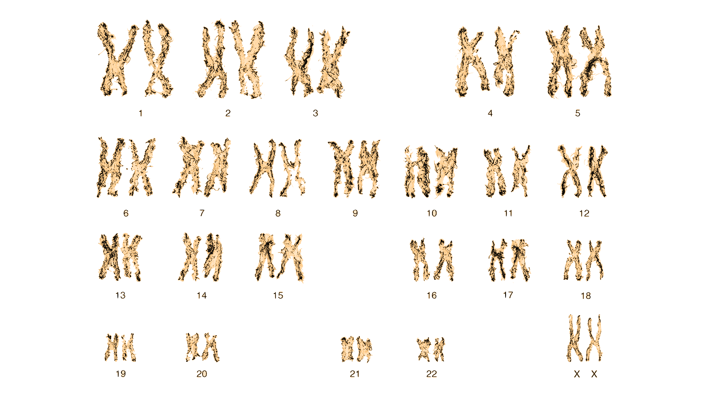
How do we Access a Location in the Genome?
Nucleus => DNA
The Cell
Notes:
https://en.wikipedia.org/wiki/File:DNA_simple.svg

Slide 24
How do we Access a Location in the Genome?
Notes:
https://en.wikipedia.org/wiki/File:DNA_simple.svg

Slide 25
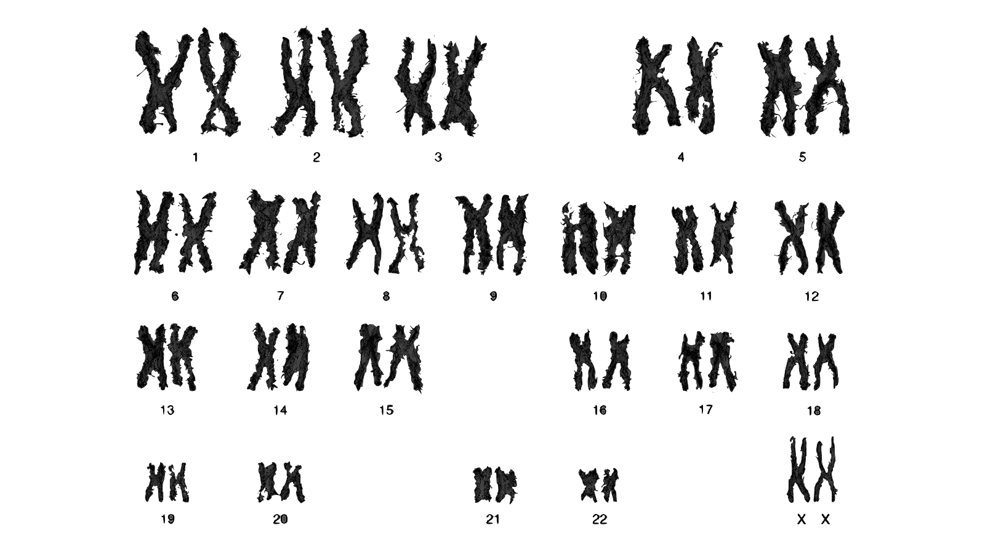
How do we Access a Location in the Genome?
GCGCTTGACACCCTTTAAAAAAATGTATTTAA…
CCGACTGGAGGCATCTCAGTGCAAGA…
AAAGAG
GCTGGTTCCTATCC…
the rest
Notes:
https://en.wikipedia.org/wiki/File:DNA_simple.svg

Slide 26
How do we Access a Location in the Genome?
GCGCTTGACACCCTTTAAAAAAATGTATTTAA…
CCGACTGGAGGCATCTCAGTGCAAGA…
AAAGAG
GCTGGTTCCTATCC…
the rest
Notes:
https://en.wikipedia.org/wiki/File:DNA_simple.svg

Slide 27
UCSC Genome Browser Demo
https://genome.ucsc.edu/cgi-bin/hgGateway
Notes:
https://en.wikipedia.org/wiki/File:DNA_simple.svg

Slide 28
The Human Genome
AGCCTTCTGGGTCCGAGGCTCCCACCTGCTCTAAGCGCTTGACACCCTTTAAAAAAATGTATTTAAAGAG
GCTGGTTCCTATCCATCCGACTGGAGGCATCTCAGTGCAAGAGCAAAGCTAAGTCCTGCACACGCTCCTC…
Reference Sequence
Notes:
https://en.wikipedia.org/wiki/File:DNA_simple.svg

Slide 29
The Human Genome
Reference Sequence
Notes:
https://en.wikipedia.org/wiki/File:DNA_simple.svg

Slide 30
The Human Genome
Reference Sequence
AAATGCTGAGCTAGGGGCAGGAGGCATGGGCGGGACAGTGTTCTGTGCCC
CCTTCTAGAGCCTAAATTTGTTGCCCGAGTTCCTCCGGGAAGCGCTCCGG
GTAGATTCTGGGGGCCGGGAGCTGAGATCCCTGGGCGGGGAGCTGGGGAA
GGGATGGGGCTGAGGACAGCGAAGAAGAGGGGGCTTGGGGGAGGGGGGAA
ATGGAAGAGAGAGGAGGGAGGAGGTACAAGAGGAAGGAGAGAAGTGCGGC
CAGCTTGCTTTCTCCAGTCGGGTGGCCGCGGGGACCCGGGCGACGTCGGA
GGCCCTGCCGGGAACCCAGGCTGCAGCCCCCACCCCCGCGCTGCGACACG
CCCCCCACCCCTTCCGGCTCACACCCCCGCCCACACTCCTGAGTGGTGCG
GTGCAGCGTCGGCCGAGGCAGCAGAGCCGAGGAGAGCAGGTGAGAAGAAG
GGCTGGGCTGGGCTGGCGGAGCGCGGTGCCGGGAGCAAGGGCGGCGGTCG
GGGGCTCTATCCAGGGACAGCACCGGGGCCGAGAGGCCCCAGGACTCGTG
GAGTCCTCTGAGTCCTGCGCAGCAGCGGCCGTCGGGGGTCAGCTAGGAAG
CTGCAGGATTGCGTTGCTTCGGTGCCTGGGCTTGGGGAGGCTTAACCATC
AGGGCTTCGGGACTCCAAGCGCATGTTCTCACTTCACTTGGCCCAGCATC
TGCTAAGTGACCAGGTCCGCGCTTTCTGTGTCTAGTCGGAGGGTCCTTGG
GTCTGACCCGACTCGCCTGAATTGCTGGTTGGCAACCGCTTCTCCCGGGA
GCAGGGGGTGGGGAAGGAGGAGCAGTGGCTGGTGGCAAGTCTGAGCCAGG
ACATAGCCGATGACAGCCTGTGAATGACCGGCCAGACTGGGGTTGGACCT
TCGGGGCAGAGCAGGCAGCCCTTGGAAAGCCAGGCTGGCAGGAGCATGGG
TGGGAGGCACAAAACACAAACAGACATATATACACATACATCCTCTAGGC
ATCTGCCCAGGAGTGATGGAGGAAGAAGAGTTGGTAGGTGGGACCACCAG
GAAACCATCCCACCCAGCTCTGCCTTCTTCAAGCTCAGGGTCCCTGAAGC
CTGACTAGTGTCTCCCGAATGGGGGGGAGGGGGGGGCTCTGGGCCAGAGC
AAAAGGAGGCATTGGCTGCATGGTCTGTAGGGCCTTTACCAACCTGACCT
TGTCCTTGCTGTCCTCTCAAAAGACTGCCATGCTCCGGTGAATCCTCACC
AGGACGCCACCTCTTTCACTTTGCAGTTGGGGGCAGCCCCTACGAACCCA
CAGCACTGGGAGGCGTGGGAACAAGCCTGTGGAGAGTGTCCCTGCACTGT
GCCAGCAAGGGCTTTACATTCTCTGCCCAGCACTGCAAGGCAGCCCCAGG
CTCCTCCATCCTTGGGCCTGGTTCATCCATCTTTCTGGACTCTCTGTTCC
TGGCAACAACCCTGCCAGGTGCCCATACATGGGCGGTGCTTGCCTCTGGG
TAGGGGTGGTGTTGGGTGGGGAGAGGGGTGAGGAAATTAGCTAAACCTCA
GCTTTAGACTTGAGAGAATAGAGGGTGGGCTGGTGGAAAACATGAGTATG
TGCCTGTGGAGGCTTAGGTTCAGGGGGATCTCAGAGGGTAGCAATTGTGA
CCCACAGCCTAATAATAACAGTCTTTGCCCTCTTGGCCTGGCTCACTTCT
ACTGTACCTTCAAAATTAATCTGCCTCTCCCCAGACTAAGGCAGGTGGCC
CCTAGGGGCCCTGGCTGCCCAGCCTCCCTGCATACCTCCCTGGGCACTCC
TATGGCATCTACACTGGCAGCCTGCAGACCCGAGACTGCCTAGGTCACAA
CGCCTCCAGCAGGCCCAGAGTCTCCCTGCCCTGGCCACAGGCCAGGCTCC
CAATTAGCCCAGATGCATCCTGGAGCACAGGGCCTTAAAGGCCTCCATTC
ACCCACGCATGCATTCCTTTCCCTCCACCAACGGAGTGAGGGAATTCACC
CTACTCCACACCAGAGATGTGGCCGGAATGCAGAGATGAAGCACTGAGCA
CAGTAGGTATGGTCTTACCCTTGAGAAGCTAGTGGGAAAGAGAGAGTTTG
ATTGGCAAAGCACTTATCTATTGGGTTCCAGGCAGGAACAAAGGCAGCAC
TCTGCCAGCAACCCCTGGTGGATTTGGATTGCCCCAGGGTGGTCAGCTGG
CCTTGGGTGACAACAGACTCATGAGAGCAGACCCTCACTTTAGGAACCAC
TCTCTCCCATATGGGGGCCCAGAGAGAACACTGTGGTCAGCACGTACAGG
TGGAAGTAGAGACTGGGGCCACGCCTGCAATGAGACCCCTATACACAGCT
GTCAGGCTCTGGCCTCCTCATGGGGCTGGGGTGGGGGTCTGTTGGCGGGA
GGTGGAGGGTTTGTGACAGGCCTATGTGGCTGCTGTGTTGATGCTTCCCA
CTTCTTGGTCCCCAGGTCCACACCTCTGCATCCCTGCACCAGGACTCACC
AAGACGCCCATCCTGGAAAAGGTCCCCCGTAAGATGGCAGCAAAAACTCC
CAGCAGTGAGGAGTCTGTGAGTGACTTTTGGAGCCCTCTCTCAACCCTGC
TTTCCCCACCTACATGCCCTTGCTTCTAGAACAGTCCTGAGTGGGACTGG
CCCCCAGCATTTGCCTGGCCCCAGCCCTGCCCTCTACTGGCACAAGGCCC
AGGCTACAGCTCCACCCCCAGCTTGCTGAGGATCCCAGAAGGGCCTGGAG
GGGCTGAGACGGGCCTCAGGGTGCCAAGGAAATGCTAAGAGCTTAACTTC
CAAATCCCCTGGCCAGGCTAGGCCCTATCTTTCCTTCCAGGGCCTCTCTT
CATCCCAGCTTCCACTTCTGATAGCTTTGAGCCCAGTGATTTTGCCTTAG
GGTGGGGCTGAATTCCTACTCCAAGCCCTGCAAGTCCCAGCTCCAGCTGC
TATCACTAGTTCAGCCTTGGAGCCTTAGGCACCATGTTCTCCACTGGCCT
GAGACAATGCCATCCTCCCTGGGCAGGCATCCTCCCTCCCGCCCCAGCCA
GCCTTCGGGTGGCAGAGCAACACACCTGACTTCAGGTGGTTGCATGTGTT
TCCCCTCTCCCACACTTGTCTTTTTGCCACTCCTCTTCCCCCTTCCCCCT
TCCCCTTTCCCCCAGCCCTCATTTGAAACCCTGAGCAGAATTTTCTGGCT
TCTCCCCAAGAAGCTGTTCACTCCATTGCCCTGAATTCTGCAGCTGACAA
ACATCTATTGTCACCTCTGGTCCACTGGCATGCTTCTCTACCCACCCCAT
TGGGCTGTGGCTTCCTTCAGAGCAGGCTCTGTTTCTCCATCGTCTCTGAG
TCCAGCCCAGGATCTGACTCACATGAACTGCCCAGGAAACATGGAGTTTT
GGAGCATTGATCTGAGACTCCCAGGTCCAAAGACACTCCTTAGCACAGGG
CCAGAAGTCCAGGAGAGTCTGGGGAGGATCCCTGGGGGGTTGAGATGTCT
GAGCTGCGATTTCCTGCTTTATTCCTTTTTACCCACTGCTGATTCCCTGT
TAGCCAGGCTAAGTCACAGCGCACTGTCAGAGCCTGGAAGAAGGGGAGCA
GTGTCTGGCAGAGGATCTAGCCAGACTTGTGGGCCCTTTTGGCCAGGTCA
CTAACTGGGCTGGGCTTTCTGTAGGTGCTCACCCACCCATCACACAGACC
ACCCCCCCCACCGCAAGAGATGGAAGAACAAGATCAGCTGGGTTGGGGGC
CCAGACCTGGCTCACTGGGGTTGGGCAGGGCAGTCTGGGATGCTGTCCAG
ATCCATCCTCGCATCATTCCCCAGGGCAGGAGCAGCCCGTAGTTGGCACT
G…
CHAT
Notes:
https://en.wikipedia.org/wiki/File:DNA_simple.svg

Slide 31

What is CHAT?
Reference Sequence
CHAT
Notes:
https://en.wikipedia.org/wiki/File:DNA_simple.svg

Slide 32
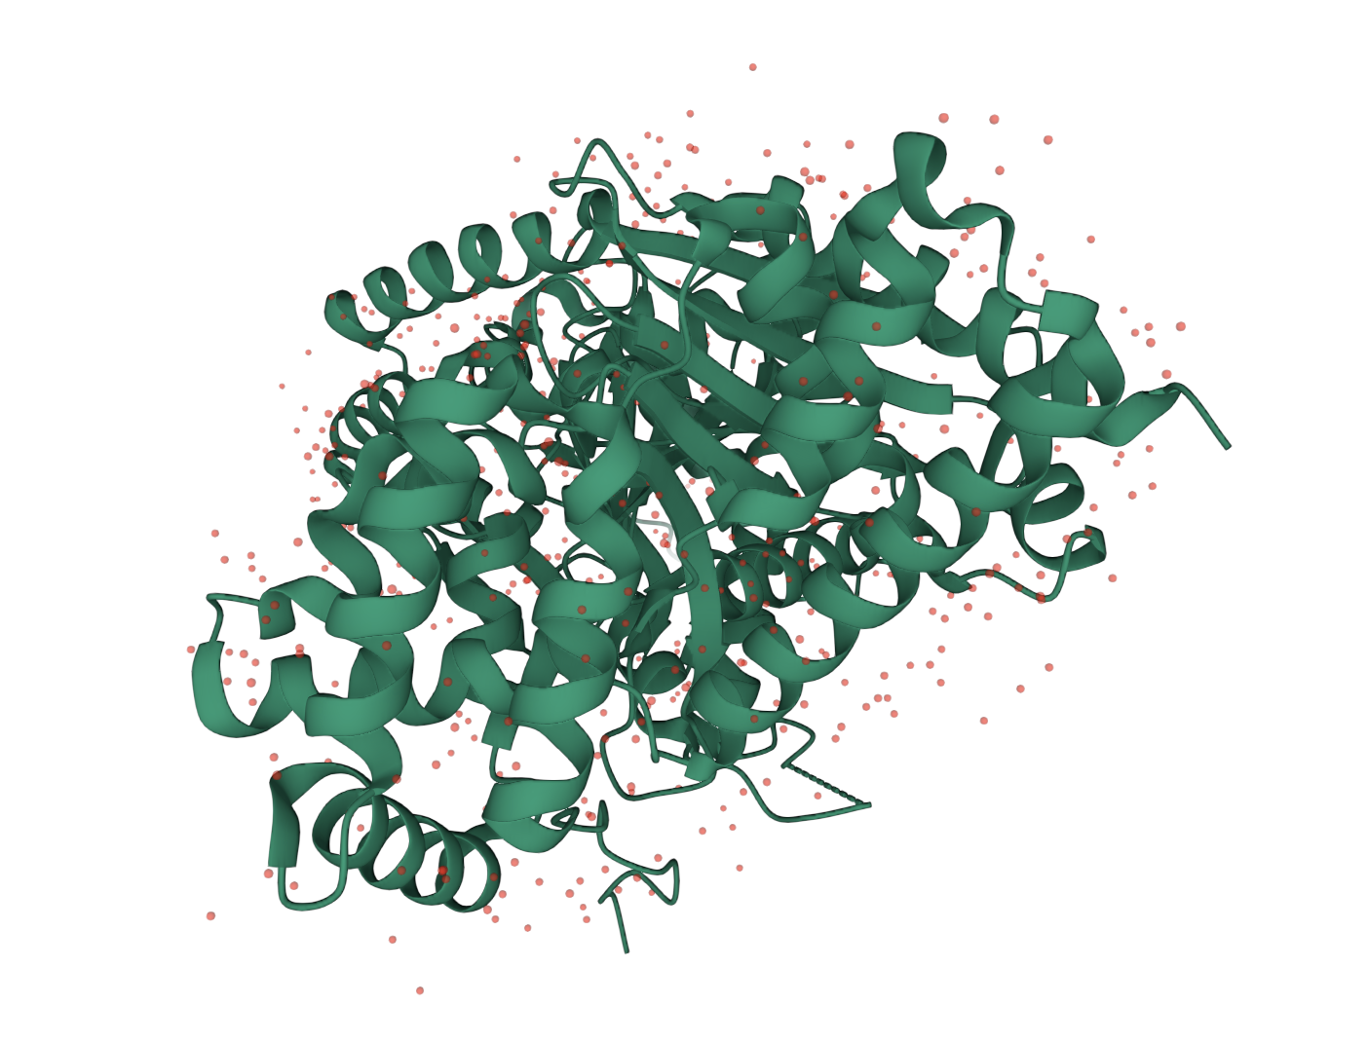
What is CHAT?
Nucleus => DNA
RNA
Protein
Cytoplasm
Reference Sequence
CHAT
Notes:
https://en.wikipedia.org/wiki/File:DNA_simple.svg

Slide 33
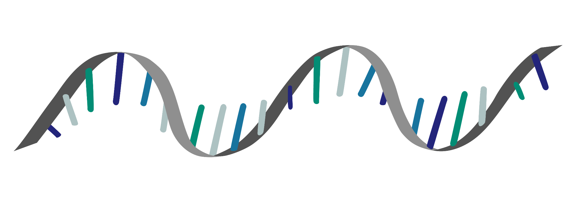
What is RNA?
Uracil
Theo Loves U
Notes:
https://en.wikipedia.org/wiki/File:DNA_simple.svg

Slide 34
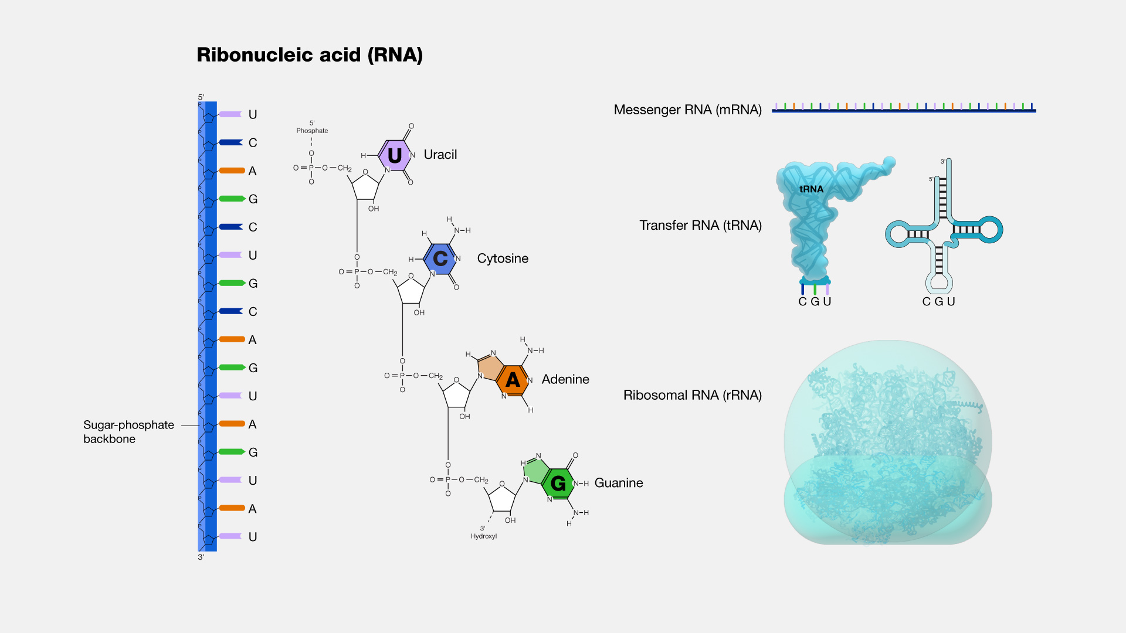
RNA Can Make Lots of Structures!
Notes:
https://en.wikipedia.org/wiki/File:DNA_simple.svg

Slide 35
Alternative Splicing
Reference Sequence
CHAT
CHAT
Notes:
https://en.wikipedia.org/wiki/File:DNA_simple.svg

Slide 36
Alternative Splicing
Reference Sequence
CHAT
RNA
CHAT RNA
RNA
Splice Signal
RNA
Notes:
https://en.wikipedia.org/wiki/File:DNA_simple.svg

Slide 37
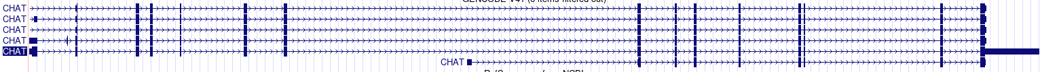
Alternative Splicing
Reference Sequence
CHAT
RNA
CHAT RNA
CHAT Spliced RNA
There are many possible splice variants!
Notes:
https://en.wikipedia.org/wiki/File:DNA_simple.svg

Slide 38
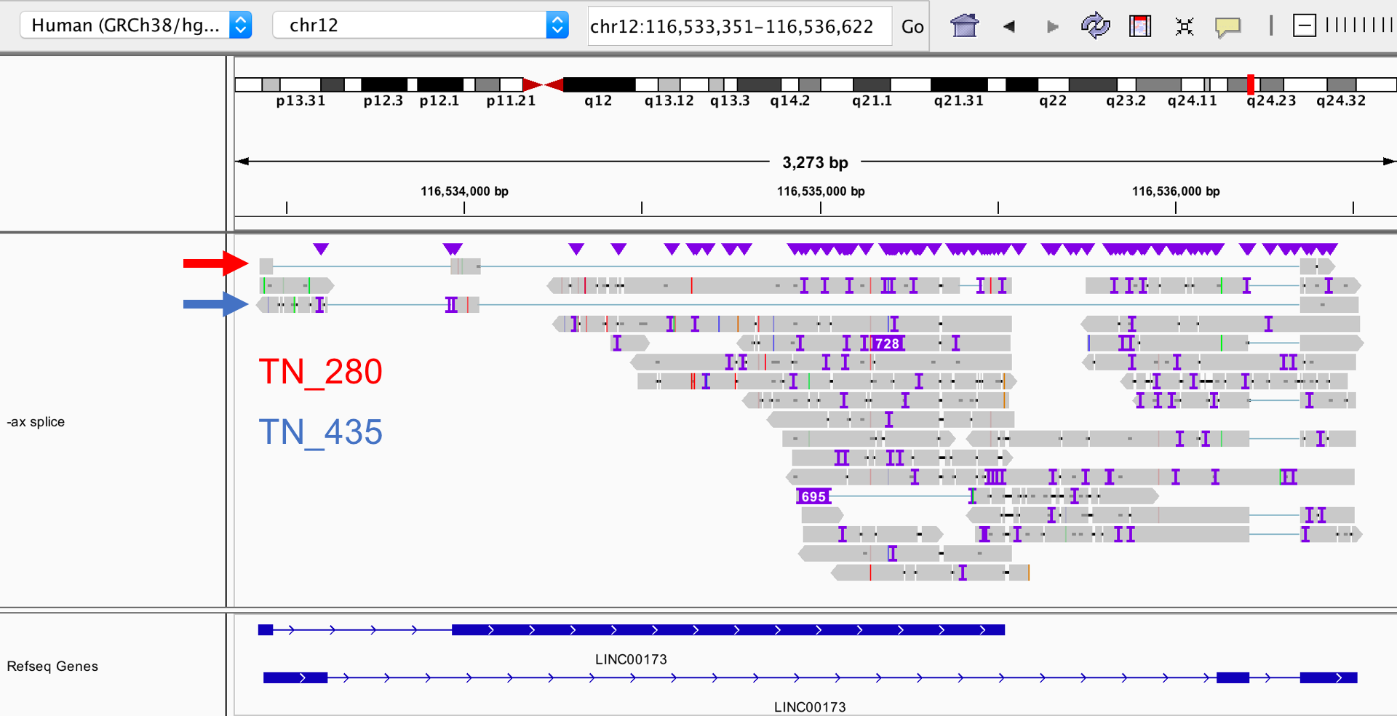
Interpreting IGV Charts
Reference Sequence
LINC00173 RNA
Notes:
https://en.wikipedia.org/wiki/File:DNA_simple.svg

Slide 39
Worksheet Time!
Notes:
https://en.wikipedia.org/wiki/File:DNA_simple.svg

Slide 40
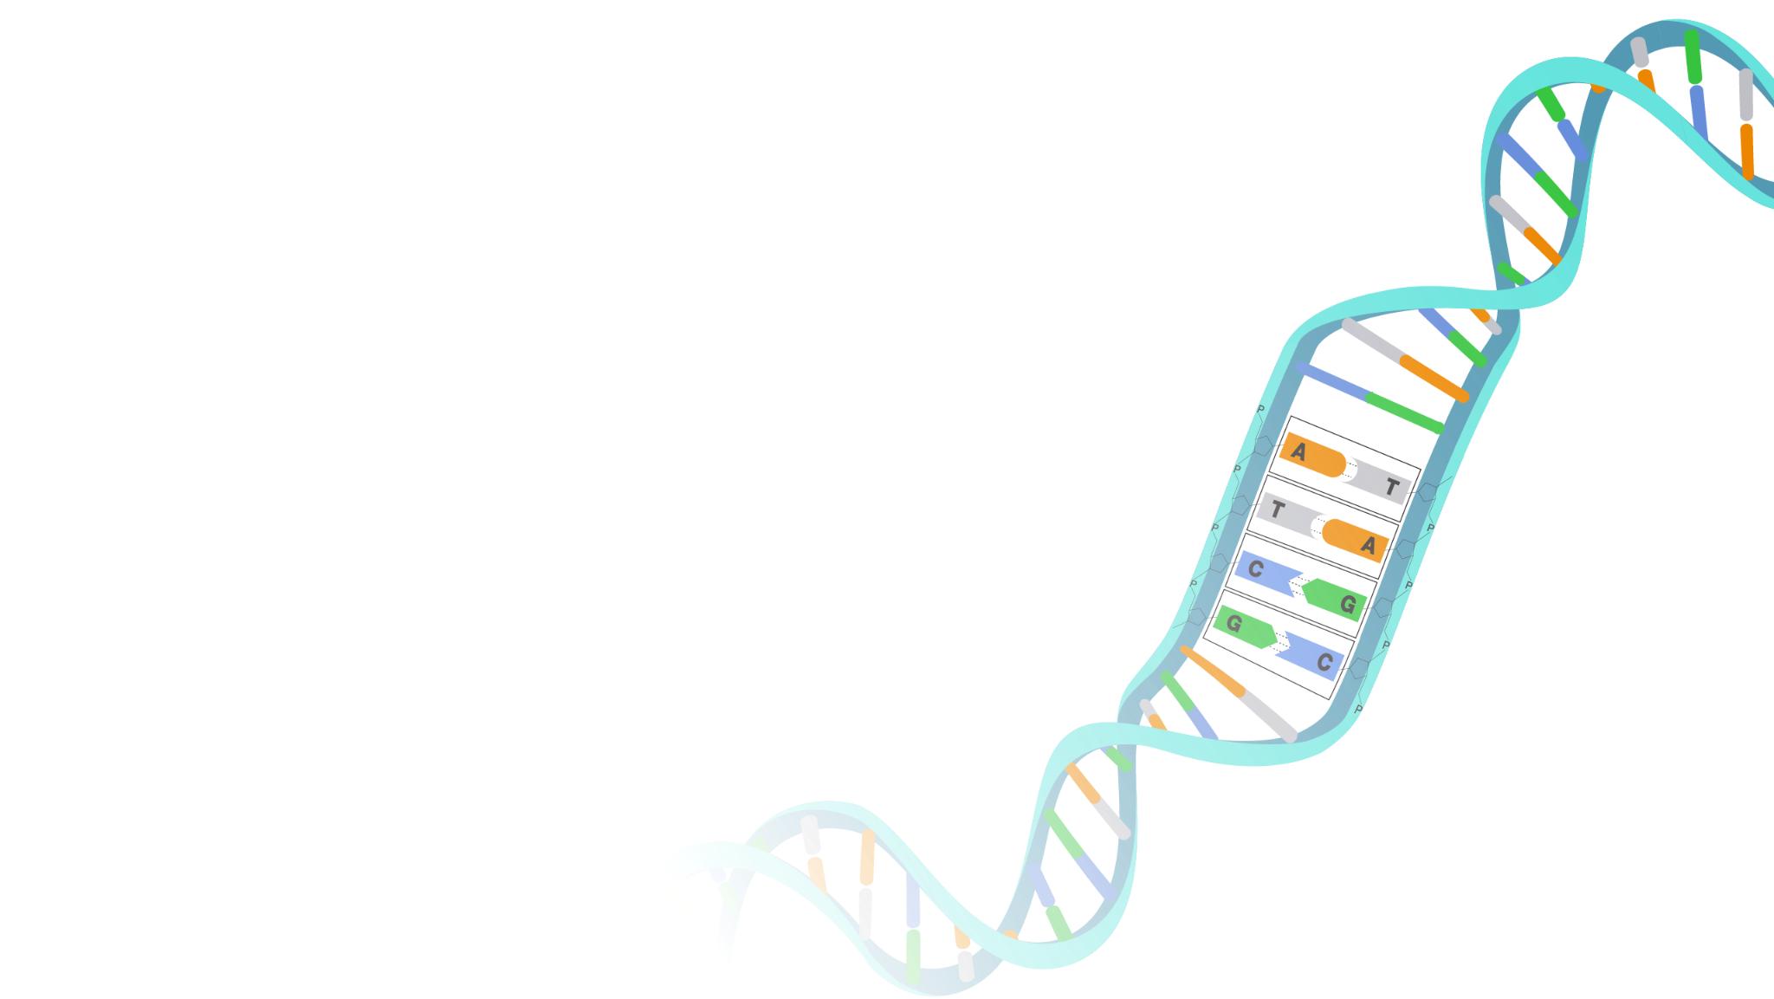
What Will I Learn?
Deoxyribonucleic Acid
Ribonucleic Acid
Sequencing
Alignment
Notes:
image: https://www.genome.gov/genetics-glossary/Deoxyribonucleic-Acid

Slide 41
What Will I Learn?
Theory
Methods !
The Great Unknown

